Slide 1
HTML5 Video & Filtering

Slide 2
Submitting GitHub Page URL
Make sure you have submitted your GitHub Pages URL
If you are unsure this was covered in Lecture 6
Go to your Repo
Click Settings
Scroll down to the section that says GitHub Pages
Under the “Source” section there’s a dropdown that says “none”
Click and select “master branch”
Click Save
Wait
When ready you will see a green section and a URL that is what you need to send to me

Slide 3
Last Week Review
Gabriel Flores Presentation
How the Internet Works
JavaScript
History of
Importance
Use Cases

Slide 4
This week overview
HTML 5 Video
Spotify Embed
YouTube Embed
JavaScript Filter Plugin

Slide 5


Slide 6
HTML5 Video

Slide 7
Open up your class-directory
Make a new HTML file called “html5-video.html”
Copy & Paste the HTML boilerplate code from “template.html” into your “html5-video.html”
Update your <title> (HTML5 Video)
Make a new folder called “video” inside of /assets
Go to https://coverr.co/ and search for a video
“animals”, “tech”, “food”, etc.
Select a video and click “DOWNLOAD FREE”
Unzip your download and place files inside of your new “video” folder inside of /assets
HTML5 Video W3Schools
Add HTML and CSS from here to get started
The JavaScript is optional and would be fun practice
Make sure to add
<source src="./assets/video/your-video.webm" type="video/webm" />
<source src="./assets/video/your-video.ogv" type="video/ogg" />
How to Embed Video Using HTML5, MDN Docs, and HTML5 Video Types

Slide 8

Done with HTML5 Videos!!!

Slide 9


Slide 10
Adding Spotify Widget
Create a new HTML file called “spotify-player.html”
Copy & Paste the HTML boilerplate code from “template.html” into your “spotify-player.html”
Update your <title> (Spotify Player)
Open Spotify Desktop Application
Go to an album
Select More Icon > Share > Copy Embed Code
Paste Embed code into your HTML file
Alternate Docs
Follow Play Button Docs

Slide 11
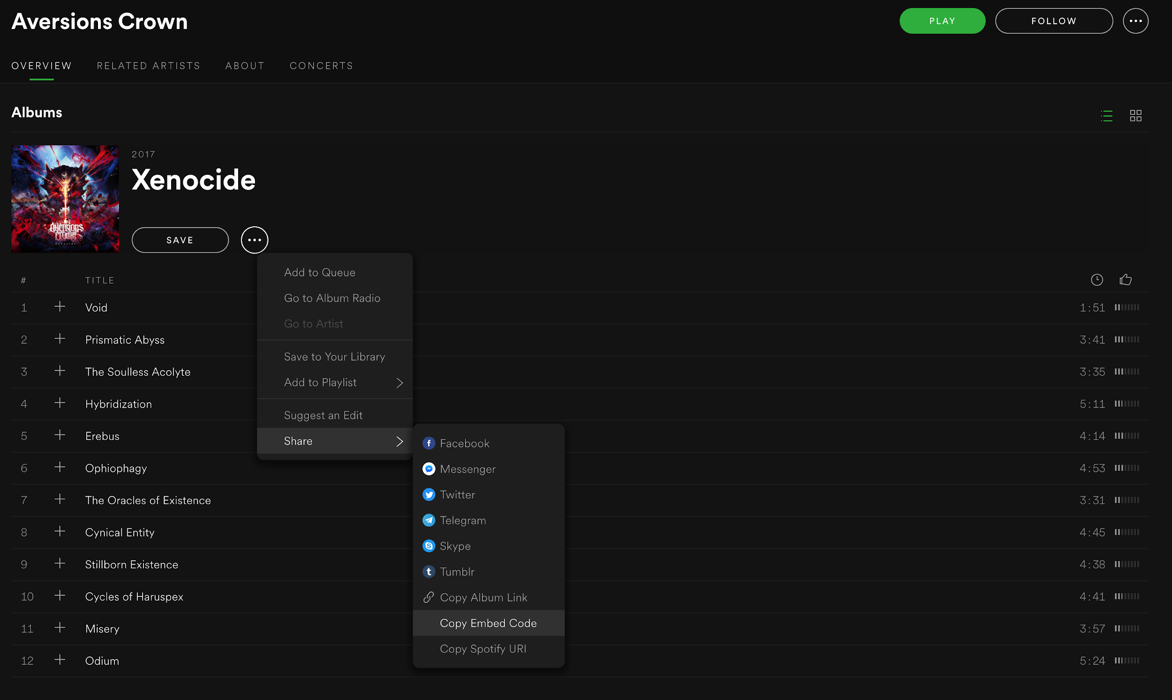
Getting Spotify Embed Code

Slide 12

Spotify Player done!!!

Slide 13


Slide 14
Adding YouTube Videos
Make a new HTML file called “youtube-video.html”
Copy & Paste the HTML boilerplate code from “template.html” into your “youtube-video.html”
Update your <title> (YouTube Video)
Go to YouTube
Search for a video
Click on video
Find the Share button
Click Embed
Copy Embed Video Code
Paste in your site

Slide 15
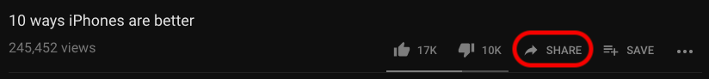
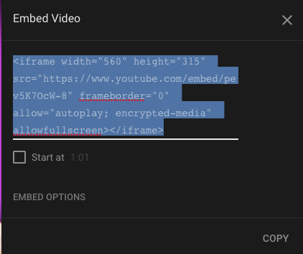
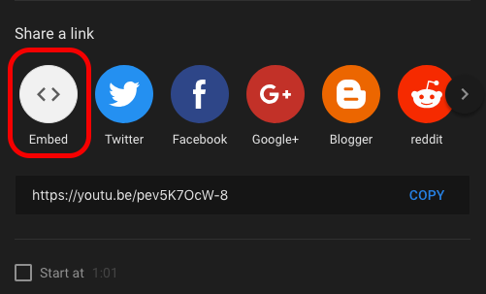
Visuals for YouTube video embed

Slide 16

YouTube Video embed ermahgerd!!!!!!

Slide 17
JavaScript Filtering

Slide 18
JavaScript Filtering
Create a new HTML file called “javascript-filtering.html”
Copy & Paste the HTML boilerplate code from “template.html” into your “javascript-filtering.html”
Update your <title> (JS Filtering)
Inside /assets/images make a new folder called /filter
/assets/images/filter
Copy the thumbnail images from /assets/images/lightbox over to /assets/images/filter
“How to Filter Elements - W3Schools”
Add HTML
Rename Categories with kittens, other, and puppies
Update the filterable elements code to use correct images and categories
Add CSS
Make sure images are responsive
Add JavaScript
Optional Plugin

Slide 19

Should now have a working JavaScript filter

Slide 20

Homework
Work on finishing your sites
Come to class with questions
Next week is an open lab for help

